Slide 1
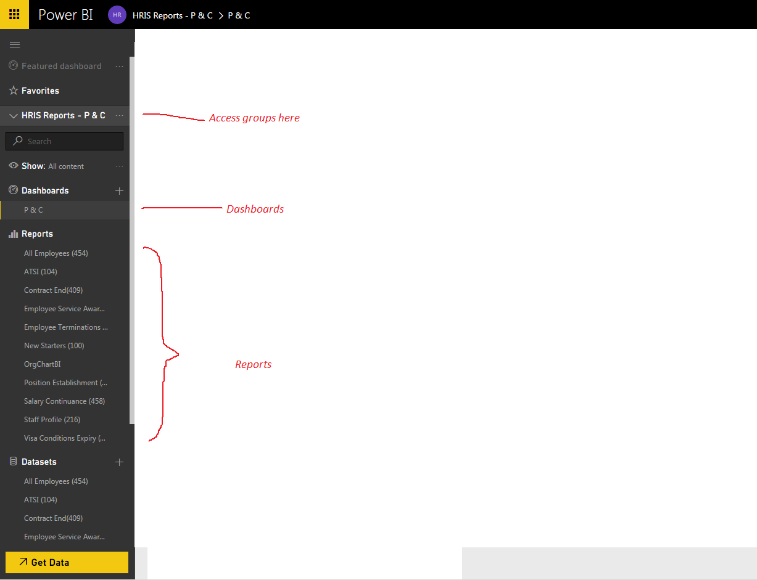
The PowerBI Interface

Slide 2
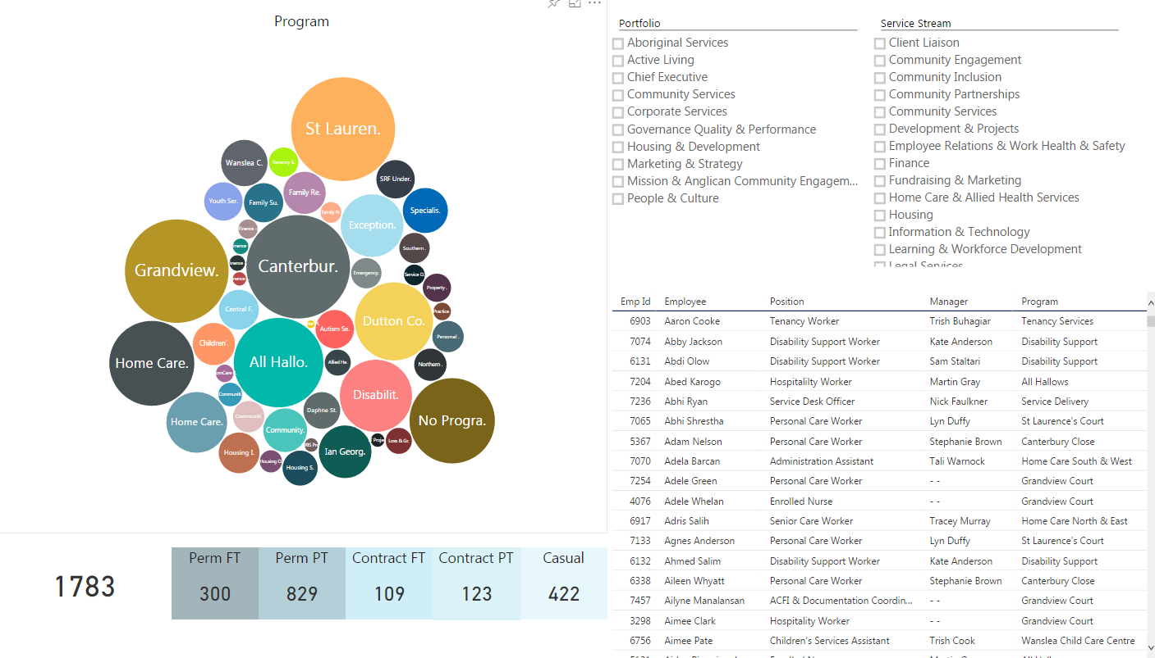
P & C – Organisation Chart (Beta)

Slide 3
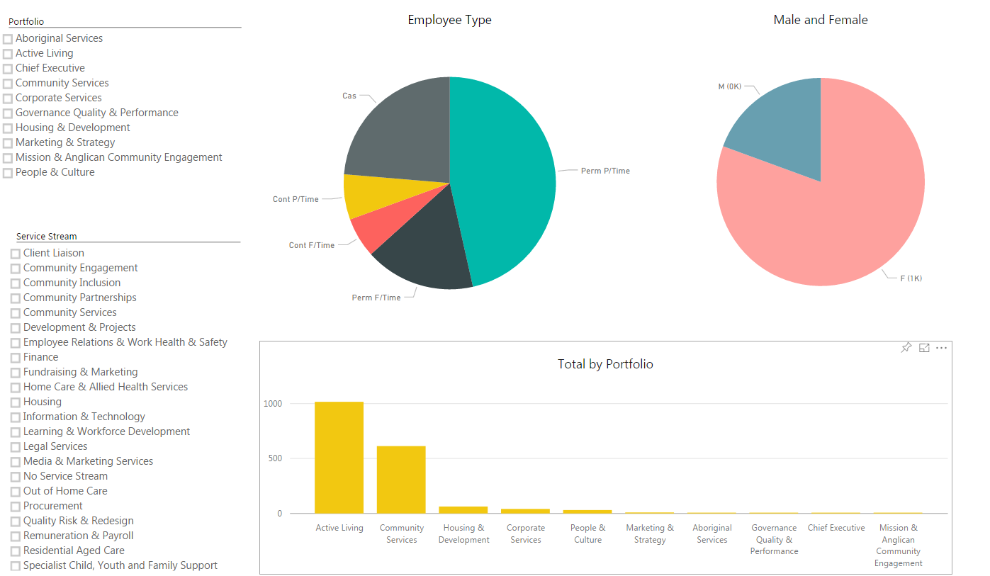
P & C - Employee types and gender

Slide 4
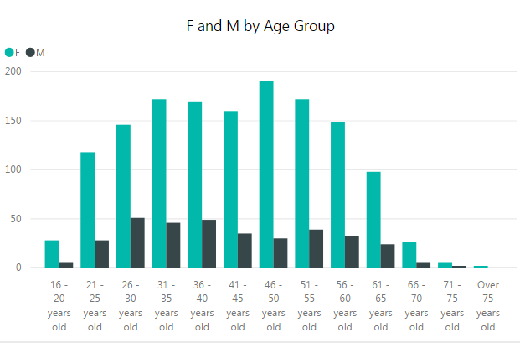
P & C – Age Profile

Slide 5
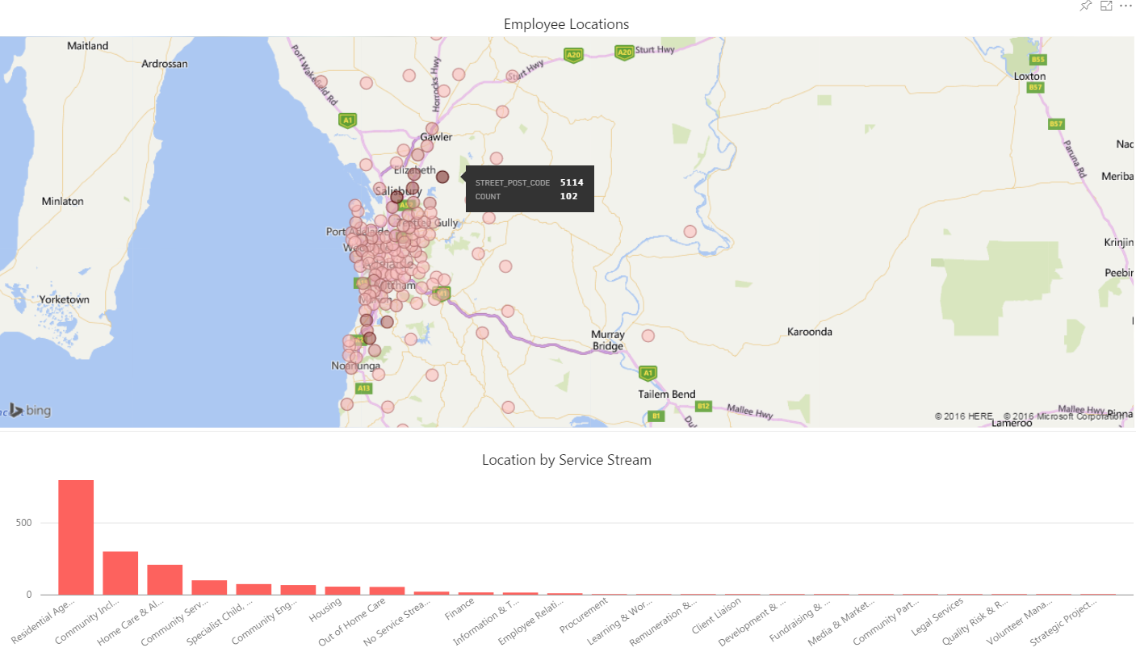
P & C - Employee Location

Slide 6
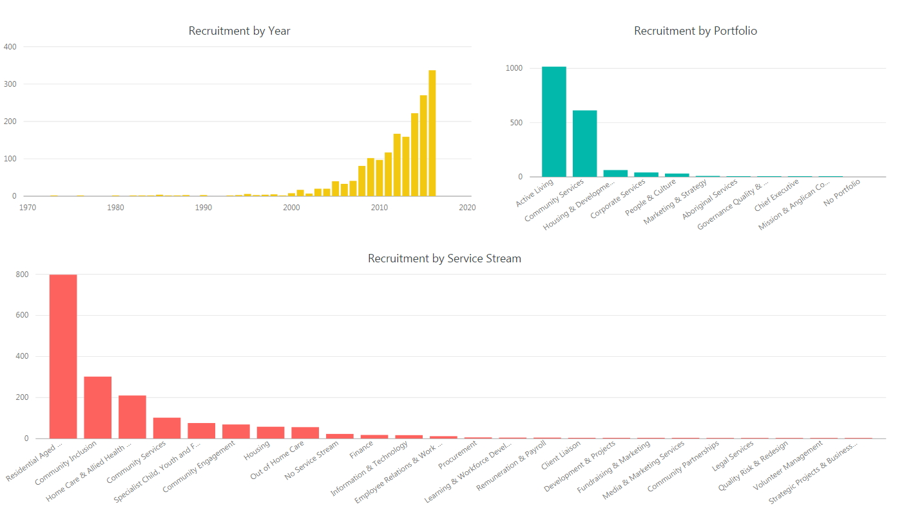
P & C - Recruitment

Slide 7
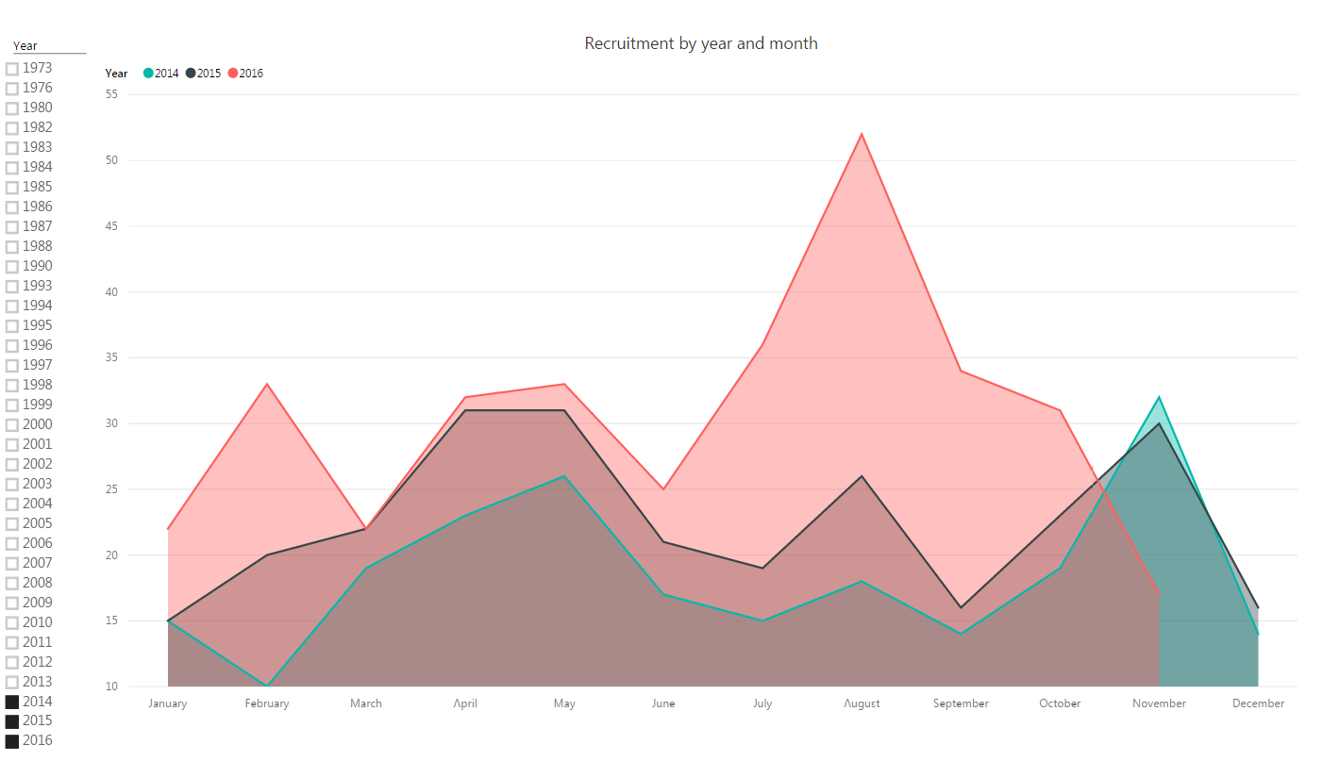
P & C – Recruitment Trends

Slide 8
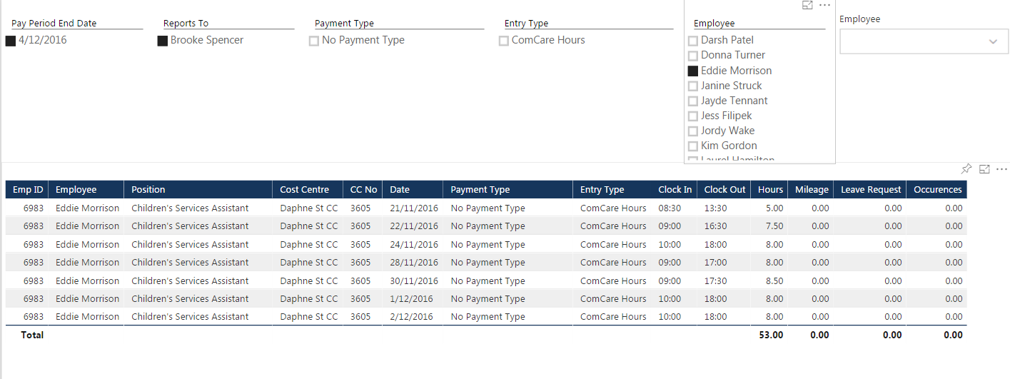
P & C - Manager timesheet report

Slide 9
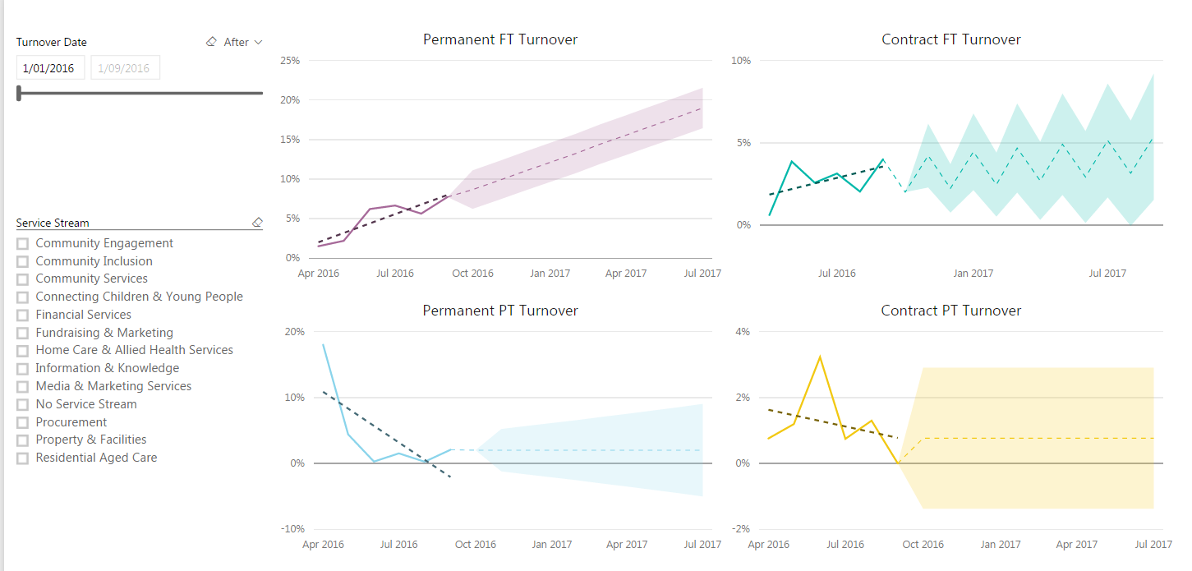
P & C – Labour turnover trends and forecasting (Beta)

Slide 10
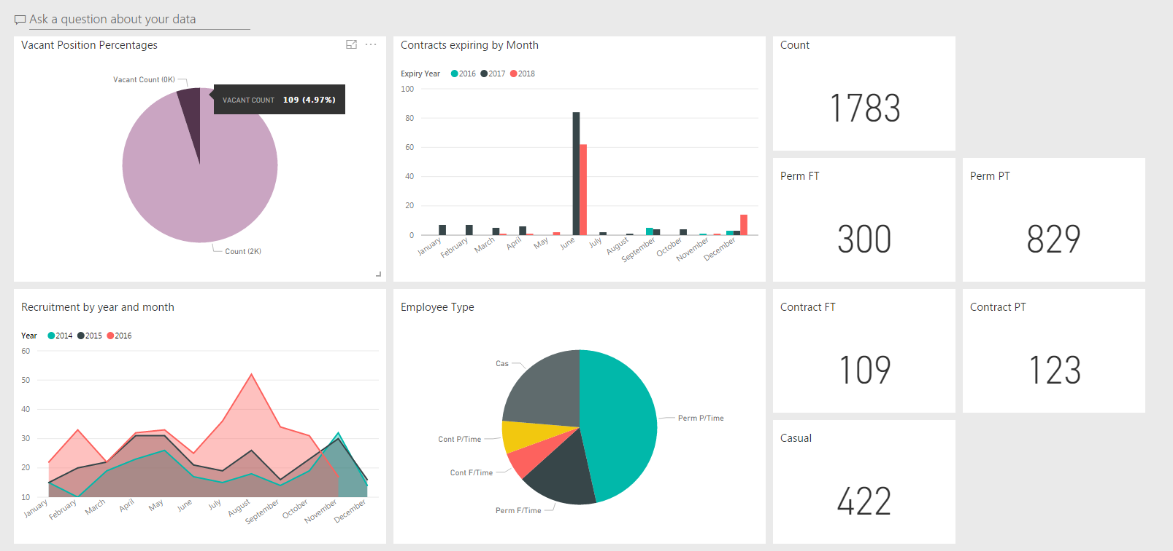
P & C – Configurable Dashboards

Slide 11
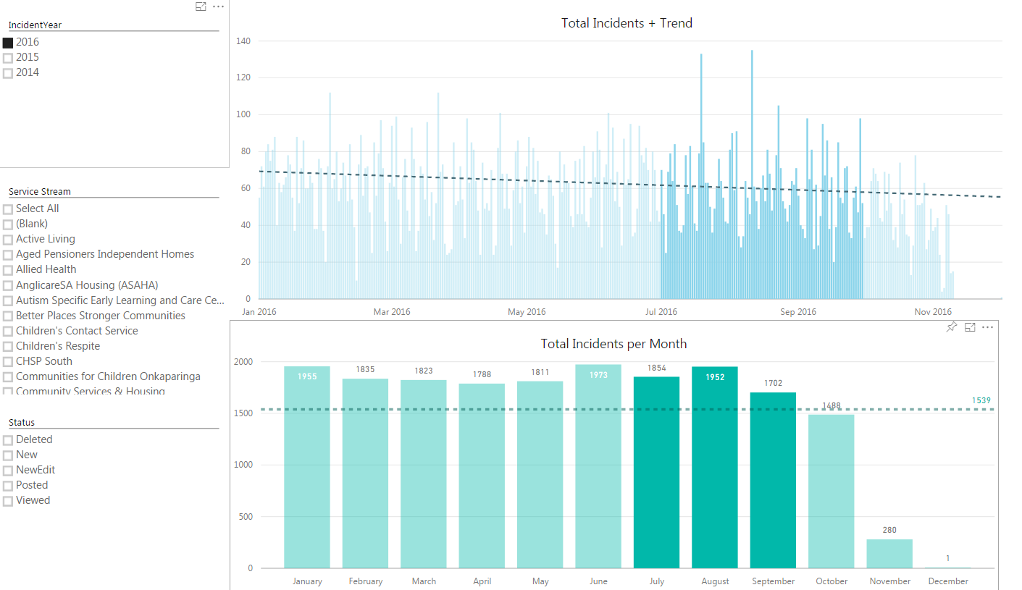
Quality & Risk – incident count and trends by month (Beta)

Slide 12
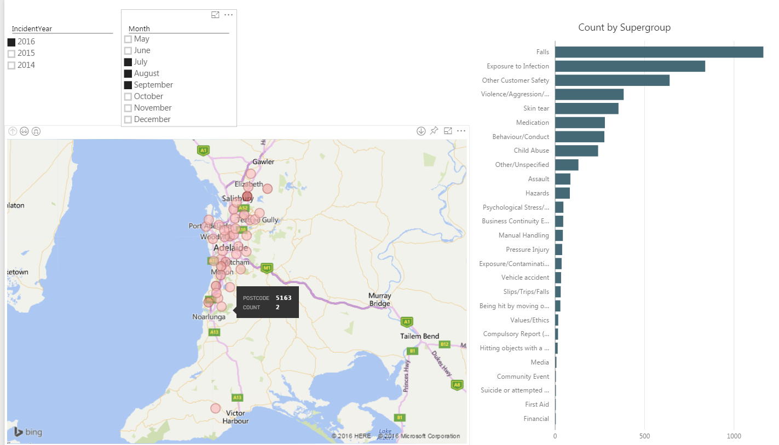
Quality & Risk – Incidents by category and location (Beta)

Slide 13
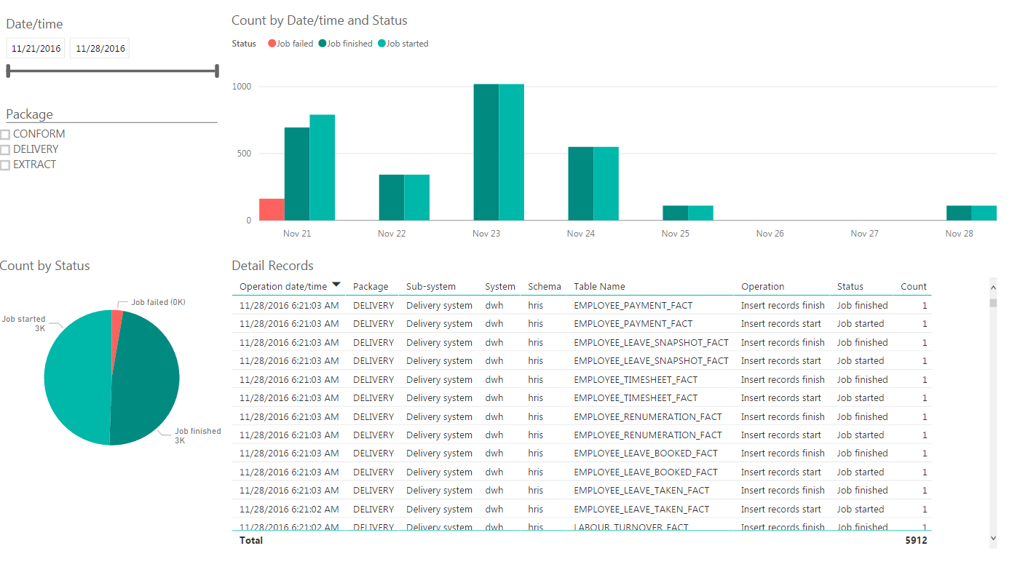
IT - Warehouse self monitoring and reporting

Slide 14
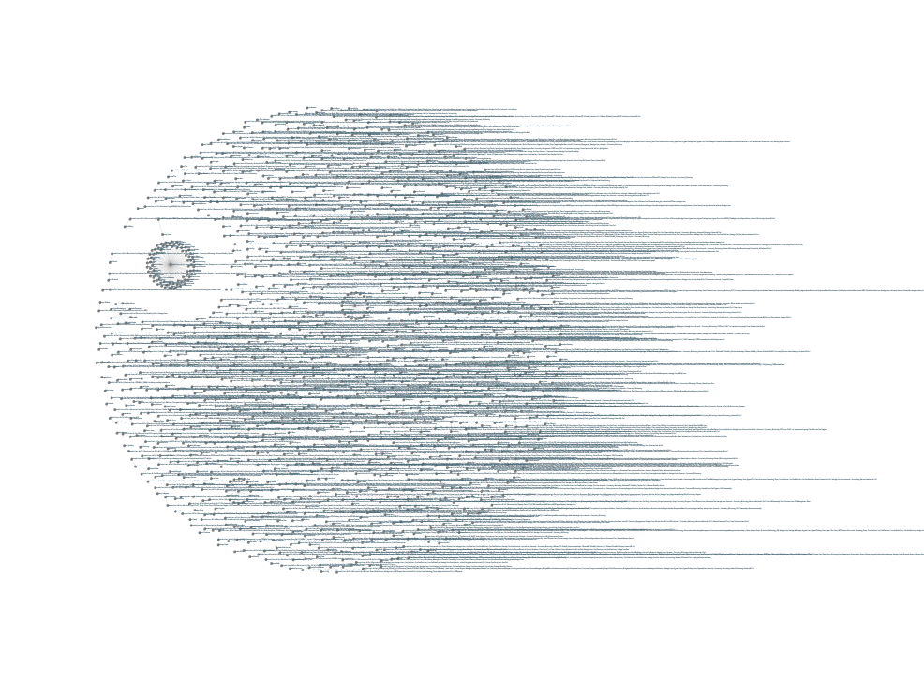
IT – AD Visualisation (aka The Death Star)

